Slide 1


Responding to ‘Big’ Emotions

Slide 2
Welcome
Please watch the following video: https://drive.google.com/file/d/1GLkmChFfBbBG81FUNte4A3DIMKkDgNvk/view?usp=sharing
Video Recap:
You are the person who is at home and supporting your child through this uncertain time
Children will be out of their usual routine and may be confused as to why this happening.
Your children may be experiencing emotions that they can’t understand, and they may be experiencing emotions they have not felt before.

Slide 3
Welcome
Children may be picking up on how we, the adults, may be feeling, and therefore not understand why they are feeling this way.
Children can’t always tell us what is wrong and how they are feeling – just because they can’t express it does not mean that they are not experiencing these emotions.
There is often a desire to “fix” the issue surrounding big emotions and make the child feel better, but it is helpful to validate their feelings
As long as your child is safe, you can take the time to let your child experience this emotion and be alongside them.

Slide 4
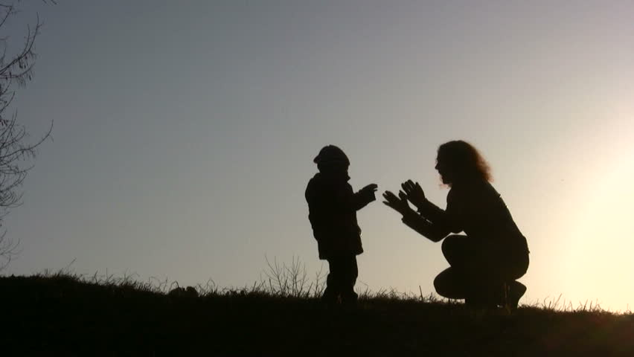
Being rather than doing
Don’t be afraid to just be with your child and listen, this is often the most valuable way. You don’t need to solve the issue straight away. Sometimes just being rather than doing is what is needed.

Slide 5



Observe, Wait, Listen
Please watch this video: https://drive.google.com/file/d/1sLS3W7OxynVW7Wpb501NyqqmICK-xxi0/view?usp=sharing
There are a few simple stages that you can use when your child is experiencing a big emotion:
Observe:
Observe and watch what they are doing
How they are trying to communicate?
Look at their body language
Waiting:
Waiting allows your child to express themselves in their own way – by doing or saying something
Gives your child a chance to take in and think about what is happening
You may need to remind yourself to wait – you could try counting in your head
Listen:
Listen for the sounds your child is making to try to understand what they are expressing

Slide 6

Labelling
Talking about what you think your child is experiencing and labelling the emotion can be a powerful way of connecting with your child.
Below are some phases you could use with your child:
            It seems like you are…
            I can hear that you are…
            I can see that you are…
            I wonder if you are…
            You seem…
It may take some time (and possibly some repetition) for your child to hear that you are acknowledging how they are feeling.
You can then gently support them in returning to a state of calm in an appropriate manner – for example moving to a new space, starting a new activity, looking at a social story.
Key phrases!

Slide 7

What is the child trying to tell us?
Please watch the following video: https://drive.google.com/file/d/1c3yfWCAla7fBYDWxILjasHh6db3wOMrO/view?usp=sharing
What is your child trying to express?
Think about a few key questions:
Have there been any changes recently, that may have resulted in this behaviour?
Did something happen just before their behaviour change, such as a trigger?
Are they expressing this behaviour to let you know
something?
Are they in pain, ill or tired?
Is this behaviour repetitive? Is it a response to
something that needs changing?

Slide 8
Where appropriate, mirror the emotion
When you believe you have an idea about what your child is expressing you can:
Listen and look for important words or actions
Repeat these back to the child, so they know that you are there and trying to help
Try mirroring the emotion, by matching some parts of the behaviour that your child is expressing – this lets them know that you are hearing them and want to understand
You can mirror back:
  in your body language
  in your tone of voice
  body movements or actions
  by simply repeating words, signs or symbols
Don’t try to change the feeling, allow your child to know that it is ok to feel these feelings and you are there to support them.

Slide 9
Use a calm and holding voice
Please watch the following video: https://drive.google.com/file/d/1gk7amJZmWzj_QmnYawf8bwJ0xMCRFqVo/view?usp=sharing
Sometimes it is not appropriate to mirror your child’s emotions, for example when they are angry.
You can support them by talking in a calm voice in order to soothe them, letting your child know that you are aware of how they are feeling.
Some ways to do this include:
  Think about how a mother may talk to her baby
  Use gentle tones
  Use song like phrases
  Be reassuring if your child needs it

Slide 10
Validating
Please watch the following video: https://drive.google.com/file/d/1hxojIzW85ozd1NFkkmjtaX0SpLnVocYF/view?usp=sharing
Sometimes it can be tempting to ‘fix’ someone who is expressing an emotion, or get them to stop, for example:
  ‘It’s OK, everything is OK’
  ‘Stop crying, crying time has finished.’
A better way to address the situation would be to use phrases such as:
  “I think you might be worried about….”
  “Let’s have a think together about how this situation is affecting you…”
We can offer our children the sense that we are trying to listen, understand and let them know that it is valid to have these emotions. We might misunderstand why they are feeling the emotion, but we have let them know that we are trying to understand and support them.

Slide 11
Look after yourself
Thank you for watching the videos.
Hopefully some of the suggestions will be useful for you in supporting your child.
On the Eden Academy Parent forum you can find Top Tips for Wellbeing, which offers some ways for you and your family to look after you mental health.
http://www.theedenacademy.co.uk/assets/uploads/Top_Tips_for_Wellbeing_03_2020.pdf
If you are worried about your child’s emotions or mental health, please contact their class teacher. If you would like, the class teacher can then ask an arts therapist to contact you.
Finally, please look after yourself at this time.

